Slide 1

House Price Prediction Challenge
Martin J Page
Create a housing price model to valuate residential real estate in Cape Town based on physical characteristics

Slide 2
The steps involved
1. What data?
Search property websites
2. Get the data
Web scaping using scrapy in Python
3. Clean the data
Python
4. Model the data
Explore
Process
Model and evaluate

Slide 3
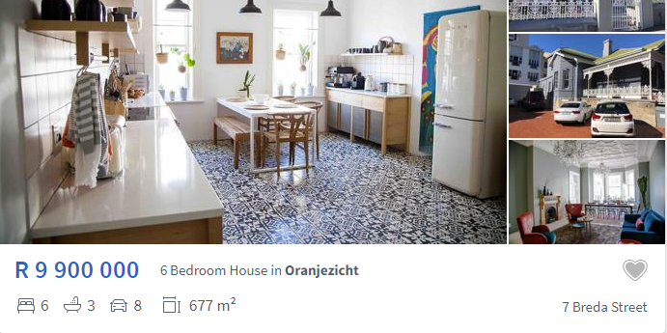
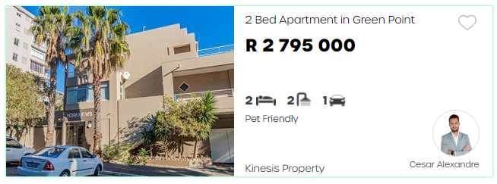
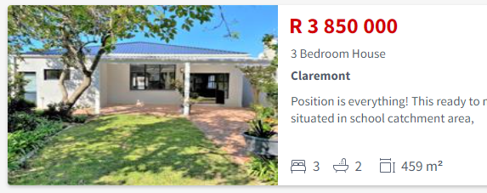
What data?
Property24
Criteria
Residential property (exclude: commercial, industrial, farms and vacant)
Property type: “House”, “Flat”/“Apartment”, “Townhouse”
Location: “Cape Town”
Aggregated websites
Extract features from the search page cards (vs opening full descriptions)
PrivateProperty
SAHometraders

Slide 4
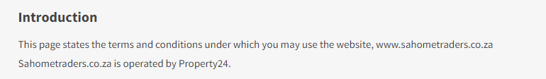
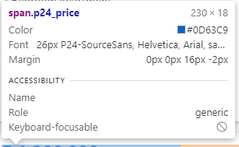
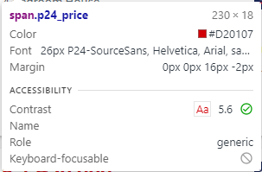


What data? Property24 vs SAHomeTraders
Property24
SAHometraders
vs
Advantages: similar html code, same information, standardised definitions
Disadvantage: duplicates

Slide 5
Get the data
Description (type)
Price
№ bedrooms
Suburb
№ bathrooms
№ parking spaces
Floor size

Slide 6
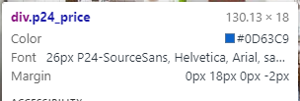
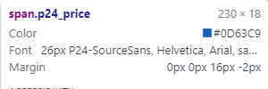
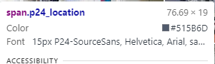
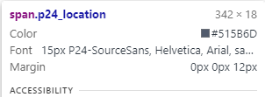
Snag with Property24
Advert of a listing on top of each page
Promoted listings as the first number of results on page 1
Promoted Listing
Standard Listing
Solution: chain on “root path” to select only main panel
selector.css('span.p24_content’).css('span.p24_location::text’)
.css ( 'span.p24_featureDetails[title = Bedrooms] > span::text')

Slide 7
Layout of web scaper using scapy
1. Setup feature paths, empty feature variables, dataframe to hold data
2. Create manually urls for page 2 to end using list comprehension
3. Loop over urls
4. Loop over the listing cards
5. Loop over the feature locators (price, bedrooms, etc.)
["https://www.property24.com/for-sale/cape-town/western-cape/432/p{0}" \ "?PropertyCategory=House%2cApartmentOrFlat%2cTownhouse".format(i) for i in range(2, 398)]
for url in urls:
html= requests.get(url).content
for selector in root_locator:
for feature, locator in feature_package: try: feature = selector.css(locator).extract_first().strip()
Abandoned: automatic urls; implement in spider class

Slide 8
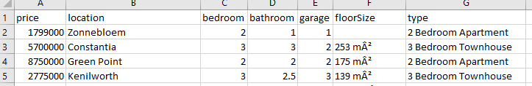
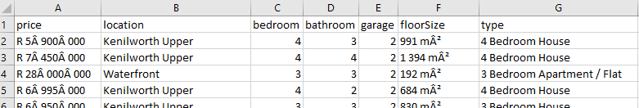
Clean the data
Property24
SAHometraders
Remove rows with missing price (target)
Remove rows with more than one missing value (abandoned: imputing)
Added under 50% of P24 to SAHome

Slide 9
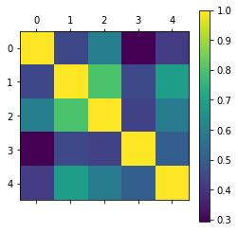
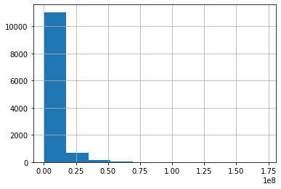
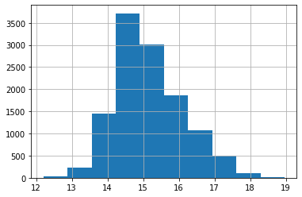
Modelling: Processing
Correlations
Bathroom and bedrooms (0.8)
Makes sense that scale together
Guest toilet?
Experimentation: better score if included
Distributions
Log Transformation

Slide 10
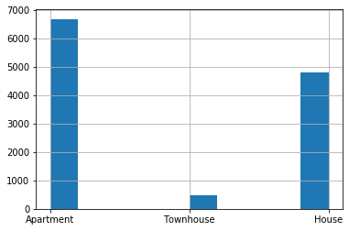
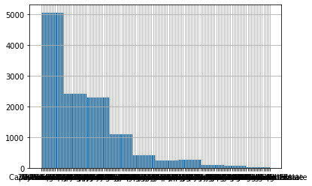
Modelling: Processing
Property type
Combine “House” and “Townhouse”
Observations per Suburb
Remove observations that to suburb with fewer than 80 examples
Abandoned: making higher geographical grid of suburbs

Slide 11
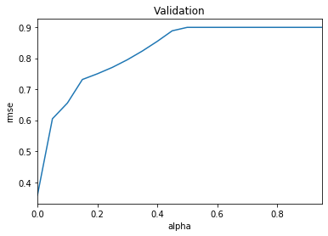
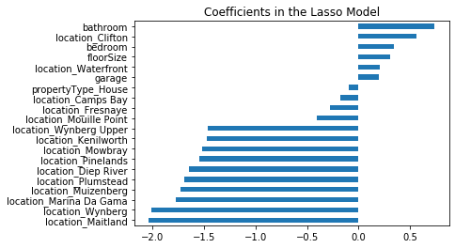
Model Building
Train (80%)/test (20%) split
Evaluate on RMSE (same units as data)
Linear regression: CV 0.358 (same for Ridge and Lasso; best alpha hyperparameter was 0)

Slide 12
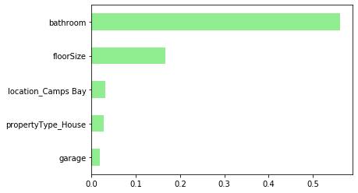
Model Building
Random forest regression: CV 0.3376 (best model after hyperparameter tuning with gridSearchCV)

Slide 13
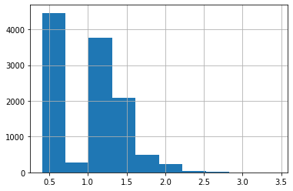
Evaluation
Prediction on hold out set:
Linear regression: R6 408 568
Random forest regression: R5 554 764
Comments:
Very poor performance
Variables not normally distributed even after log transformation
Features do not capture some essential driver(s) of house prices – i.e. houses with a similar number of bedrooms, bathrooms, etc. are priced very differently

Slide 14
Suggested improvements
Main improvement: scrape more features e.g. Spider class in scrapy to open up the listings and extract information for the full detail page
Kitchens, lounges, reception rooms, erf size, key words like “heritage”
More data by expanding suburbs – train other relationships better; more representative
Improved data processing and transformations
Robust model building, e.g. interaction terms, adding features that make significant difference

Slide 15
What I would like to learn
Advanced string manipulation
How to make decisions for preprocessing – the right transformations based on the maths
Statistical basis on linear regression
Efficient workflow – PyCharm vs Jupyter, overwriting, savings outputs
Acknowledgments: https://www.kaggle.com/apapiu/regularized-linear-models for regularised linear model regression tutorial

